Slide 1






PISA 2018
How does it work?
December 2019

Slide 2
Introduction
The purpose of PISA is to compare the performance of 15 year olds in a range of domains in 79 countries across the world.
This does not mean every 15 year old student in every country gets tested on everything. There are two finite resources which prevent this from being possible.
It costs money to conduct student assessments
People get tired. If the aim was to cover every area of every domain, students would spend several hours doing the tests and fatigue would seriously impact their performance.

Slide 3
Sampling
To get around the problem of cost, countries test a sample of students rather than the whole population. Sampling methodology varies by country depending on their demographics and schooling systems.
In Scotland the school sample is stratified on the basis of:
Previous exam performance
Urban/rural location and school size
Whether schools were publicly funded or independent
Whether schools were single-sex or mixed

Slide 4
Sampling
40 students are then randomly sampled from each school.
This means a student in a school which has 50 students has an 80% chance of being chosen (40/50), while a student in a school which has 200 students has a 20% chance of being chosen (40/200).
To make sure the sample represents the population, weighting is applied to take this into account. In this scenario, students in the second school would have a weighting which is four times the size of the weighting students in the first school would have.
Clearly there is likely to be more variation in a group of 40 pupils out of 200 compared to a group of 40 pupils out of 50. So how can we make sure we take the variance in the whole sample into account properly if groups have different weights and variances?

Slide 5
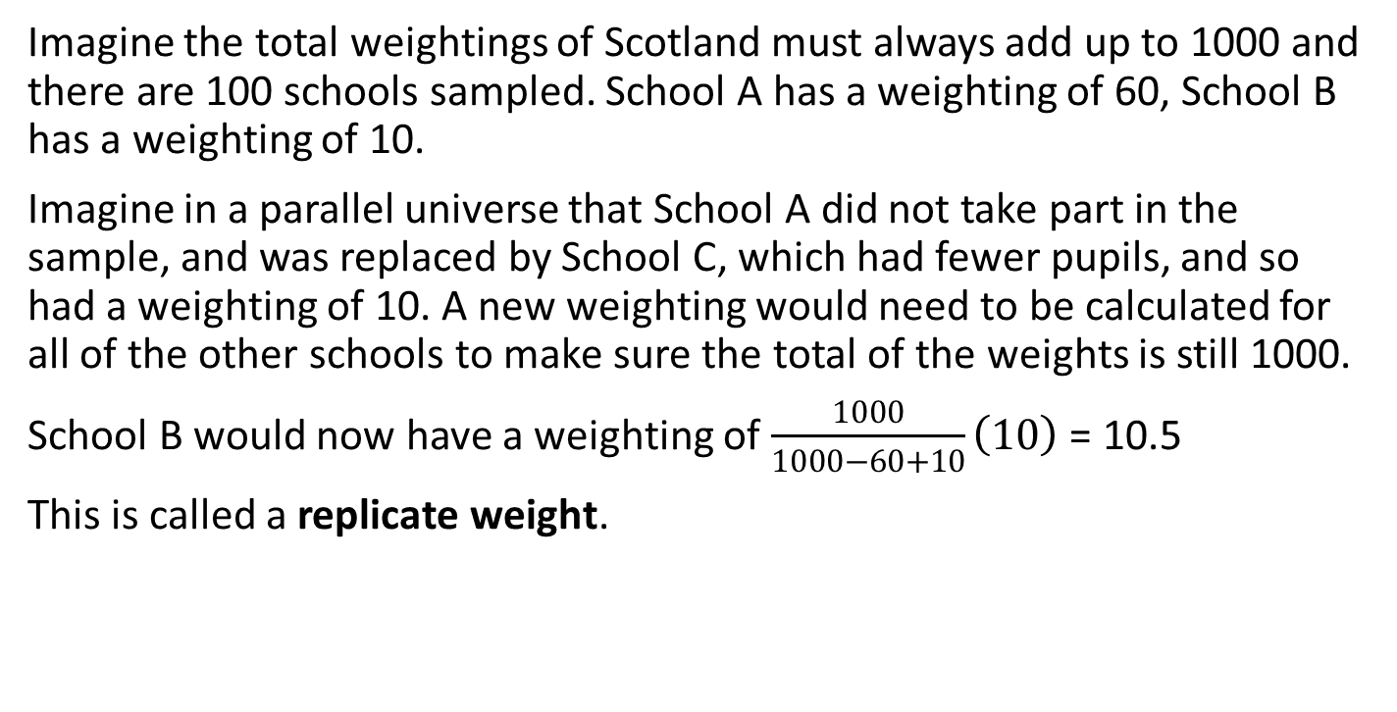
Sampling
Imagine the total weightings of Scotland must always add up to 1000 and there are 100 schools sampled. School A has a weighting of 60, School B has a weighting of 10.
Imagine in a parallel universe that School A did not take part in the sample, and was replaced by School C, which had fewer pupils, and so had a weighting of 10. A new weighting would need to be calculated for all of the other schools to make sure the total of the weights is still 1000.
School B would now have a weighting of $\frac{1000}{1000−60+10}\left(10\right)$ = 10.5
This is called a replicate weight.

Slide 6
Sampling
In the calculation of replicate weights in PISA, weightings are not added or removed in this way, but the impact of them is changed (e.g. we see what would happen if the weight of School A was cut in half or if the weight of School B was doubled).
80 replicate weights are calculated for each original weighting using this method to give a spread of weights which must be taken into account in the calculations. This ensures that if any school is having an unusually large impact on results, the variance (and standard error) will take this into account properly.
This allows PISA to accurately predict percentage results of responses to pupil questionnaire questions (and other calculated variables from the pupil questionnaire, such as ESCS) within a margin or error.
But what about performance in Reading, Science and Maths?

Slide 7
Assessment Design
People get tired. PISA assessments are currently 3 hours long. Even this length of exam can be demanding for some students. It is impossible for the test to cover every aspect of every domain. Therefore questions get packaged into clusters within domains.
Every 3 years there is a different ‘main domain’ which every student gets assessed on. In 2018 it was Reading, so every student was assessed on Reading, with some students assessed on Maths and some on Science.
In most countries in 2018, the following will be true:
44% of students did clusters in reading and science
44% of students did clusters in reading and mathematics
12% of students did clusters in reading, mathematics and science

Slide 8
Assessment Design
In Scotland (and 8 other countries) in 2018, it was slightly different because Scotland took part in the Global Competency domain.
In Scotland in 2018:
33% of students did clusters in Reading and Science
33% of students did clusters in Reading and Mathematics
22% of students did clusters in Reading and Global Competence
12% of students did clusters in Reading, Science and Mathematics
This is why in the 2018 data we see higher than normal standard errors for Science and Mathematics. Because fewer students sat clusters in these domains, more estimation was needed to calculate the average score.

Slide 9
Assessment Design
Let’s consider a very simplified example.
Imagine a student answers Question A correctly but doesn’t answer Question B correctly. They don’t answer Question C.
From the limited knowledge we have, we might say that the student has a 50% chance of answering Question C, since we know they could answer A but couldn’t answer B, but we know nothing about the difficulty of either question.
Now imagine this situation with a database of 700,000 students around the world where several thousand of them answered Questions A, B and C. From this dataset we can see that 75% of students who answered Question A correctly but didn’t answer Question B correctly answered Question C correctly. This allows us to make an informed prediction of how likely it is the student will answer Question C correctly.

Slide 10
Assessment Design
It’s much, much more complicated than this in practice, but effectively it becomes possible to predict the likelihood of students answering questions correctly in Science based on their Reading and Maths scores, or in Maths based on their Reading and Science scores.
The student’s response to the question is not the only factor considered in this prediction. The country they are from, the performance of students in (e.g. Science) who performed similar to them in Reading, and characteristics such as ESCS are also taken into account.
It does not produce a set number of the probability. All of this information and all of these factors combine in a predictive program which generates plausible values

Slide 11
Plausible Values
A plausible value is exactly as it sounds. It is a PISA score randomly generated by a program based on the predictive information available about the student. Every time this predictive program is run it produces a result that is plausible. The more times we run the predictive program (i.e. the more plausible values we have) the more accurate the result will be for the student’s PISA score.
In an ideal world, we would be able to have hundreds of plausible values, but the calculations use a very large amount of processing power.
Up until 2012, 5 plausible values were used. In 2015 and 2018, 10 plausible values were used. Maybe as processing power increases over time, the OECD will recommend that more plausible values are used for PISA.

Slide 12
Plausible Values with no weights
Let’s consider flipping a coin 10 times. If you flip a coin 10 times you would expect to see 5 heads and 5 tails – but it’s perfectly plausible that the result could be 8 heads and 2 tails.
If we say the score is ‘percentage of heads’, with only 1 plausible value we could easily end up with this score being 80%. With 5 plausible values, coming up with an overall score of 80% is much less likely. That would require 40 of the 50 coin tosses to be heads. With 10 plausible values it would require 80 of the 100 coin tosses to be heads. If this happened you would have suspicions that the coin is biased.
In reality, what would probably happen is we would end up with something like this:
PV1 = 80% ; PV2 = 60%; PV3 = 40%; PV4 = 20%; PV5 = 50%
PV6 = 30% ; PV7 = 70%; PV8 = 70%; PV9 = 20%; PV10 = 80%
From this we can work out the mean score and the standard error

Slide 13
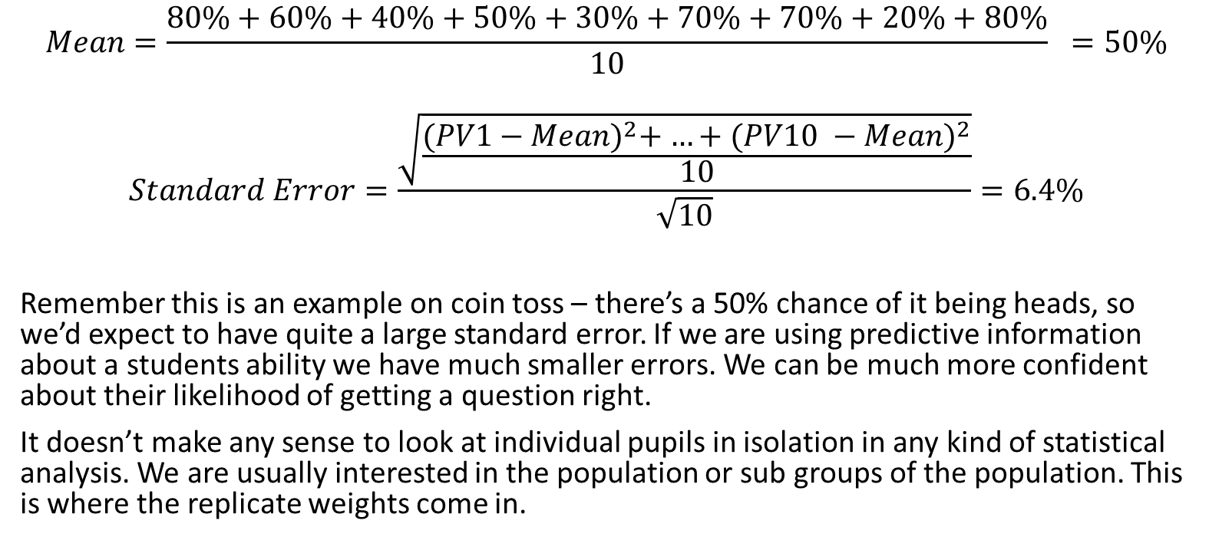
Plausible Values with no weights
$$Mean=\frac{80\%+60\%+40\%+50\%+30\%+70\%+70\%+20\%+80\%}{10} =50\%$$
$$Standard Error=\frac{\sqrt{\frac{{(PV1−Mean)}^{2}+{ …+(PV10 −Mean)}^{2}}{10}}}{\sqrt{10}}=6.4\%$$
Remember this is an example on coin toss – there’s a 50% chance of it being heads, so we’d expect to have quite a large standard error. If we are using predictive information about a students ability we have much smaller errors. We can be much more confident about their likelihood of getting a question right.
It doesn’t make any sense to look at individual pupils in isolation in any kind of statistical analysis. We are usually interested in the population or sub groups of the population. This is where the replicate weights come in.

Slide 14
Plausible Values with weights
To fully take into account all of the variance, and to ensure the overall scores for all students in a distinct population (e.g. Scotland) are accurate, the PISA calculations work out results for every weighting applied to every plausible value for every student in Scotland. It uses the predictive program to create 10 plausible values for each student, with associated errors, and then runs each of the 81 replicate weights on each of the 10 plausible values (resulting in 810 calculations)
By taking these steps we can ensure that the estimation of results and the errors around them are accurate and comparable across countries, meaning if we conduct significance tests and find significant differences, we can be confident that these differences are real.

Slide 15
Conducting Analysis
Always do analysis using replicate weights and, where appropriate, plausible values. If you don’t then your results will not properly take errors into account and will not be consistent with what the OECD publish.
If you are an external user and have either SAS or SPSS you can use the IDB Analyser to generate code that will take all of this into account.
Detailed guidance on how to use the IDB Analyser is available on the website: https://www.iea.nl/data-tools/tools#spy-para-308

Slide 16
Conducting Analysis
PISA provides a rich source of data with almost endless possibilities of analysis that can be done on it.
If you are interested in conducting analysis on Scottish PISA data and want to make sure you are on the right track, please get in touch with a member of the PISA team in Scottish Government:
Keith.Dryburgh@gov.scot
Adam.Naylor@gov.scot

